Slide 1


Enterprise Risk Management
ERM Training Material
Notes:
Cover Page

Slide 2
ISO 31000 ERM Framework (overview)
Based on the ISO 31000 standard on risk management which involves a 7 step process:
Establish the Context
Establish the Context: Set internal, external, and risk management context
Identify Risks
Identify Risks: What can go wrong
contents
Communicate & Consult
Monitor & Review
Analysis Risks: Understand the likelihood and impact
Analyse Risks
Evaluate Risks
Evaluate: Document and evaluate the existing controls
Treat Risks
Treatment Options: Reduce, avoid, transfer or retain
Notes:
An overview of the ERM framework
Framework is based on ISO 31000 which is considered as the most leading risk management framework and is used globally

Slide 3
ISO 31000 ERM Framework (Risk Owner)
A Risk Owner :
Is a person or entity with the accountability and authority to manage a risk
Focuses on:
Identification and analysis – ensures effective and timely risk identification and analysis
delivery – ensures effective and timely implementation of the risk mitigation plans
‘Risk belongs to each relevant employee’
contents
Notes:
Definition of Risk Owner
Role of risk owner

Slide 4
ISO 31000 ERM Framework (Risk Champion)
A Risk Champion:
is a person who ensures that the framework is properly implemented in their own business unit, team or function
Focuses on building:
capacity – increase staff exposure to risk management
capability – increase the ability of the risk owners to understand and manage risks effectively
contents
Notes:
Definition of Risk Champion
Role of Risk Champion

Slide 5
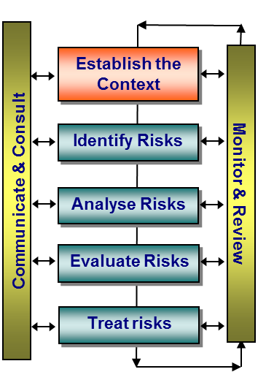
ISO 31000 ERM Framework (Establish the Context)
Establishing the right context is the foundation to effective risk identification. It involves:
Review and understanding of the company’s strategy and business plans
Review of the key trends in the relevant industry sectors
Review and understanding of the key risks reported by the global mining companies
Review of the previous management and audit reports to get an insight into high risk areas
Establishing the right context enables to focus its risk management efforts to suit the environment in which it operates
contents
Notes:
1st step of ERM framework
Shows importance of understanding the strategy, business plan and relevant industry sectors for effective risk identification

Slide 6
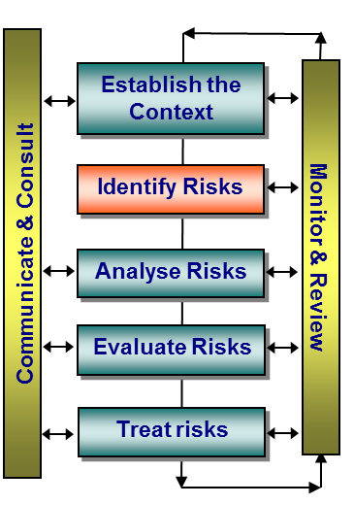
ISO 31000 ERM Framework (Identify Risk)
The aim of risk identification is:
To expose and document all currently knowable risks, both opportunities and threats that could affect the activity, project or objective in question
The risk identification process:
Identifies risks and possible triggers and consequences to understand Ma’aden’s overall risk exposure
There are many ways to identify risks i.e. Company’s Risk categories, judgements based on experience and records, expert opinions, brainstorming, risk interviews, scenario analysis etc.
contents
Notes:
2nd step of ERM framework
Aim and importance of risk identification
Ways to identify risk

Slide 7
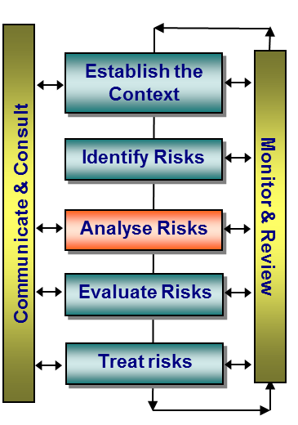
ISO 31000 ERM Framework (Analyse risk)
‘Risk Rating’ is the combination of selected likelihood and impact ratings to establish the level of risk.
‘Risk likelihood’ is the probability or frequency of a risk event happening.
‘Risk Impact’ is:
The outcome of a risk event or situation is expressed qualitatively or quantitatively, being a loss, injury, disadvantage or gain
Severities can range from “low” to “extreme” and are expressed in terms of Economic and Non-Economic
Notes:
3rd step of ERM framework
Definition of likelihood , impact and risk rating

Slide 8
Risk Likelihood Ratings
ISO 31000 ERM Framework (Analyse Risk)
contents
Notes:
Risk Likelihood scale

Slide 9
Company X Impact Scales
ISO 31000 ERM Framework (Analyse Risk)
Impact Types |  | Impact Severity
 |  | 1 – Very Low | 2 – Low | 3 – Moderate | 4 – High | 5 – Very High
Economic | Expansions & Investments | <=X Million SAR increase in approved budget for expansions / new projects X = 50M for (Corporate), X=25M for (MPC), X=50 and Y=50M for (MAC, MRC, MBAC), X=25 for (MGBM), X=10M for (MIC and MIMC) | > X Million SAR and <=Y Million increase in approved budget for expansions / new projects X = 50M and Y=100M (Corporate), X=25M and Y=50M (MPC), X=50 and Y=100M (MAC, MRC, MBAC), X=25 and Y=50M (MGBM), X=10M and Y=15M (MIC and MIMC) | > X Million SAR and <=Y Million increase in approved budget for expansions / new projects X = 100M and Y=150M (Corporate), X=50M and Y=75M (MPC), X=100 and Y=150M (MAC, MRC, MBAC), X=50 and Y=75M (MGBM), X=15M and Y=20M (MIC and MIMC) | > X Million SAR and <=Y Million increase in approved budget for expansions / new projects X = 150M and Y=300M (Corporate), X=75M & Y=150M (MPC), X=150M and Y=200M (MAC, MRC, MBAC), X=75M & Y=100M (MGBM), X=20M and Y=25M (MIC and MIMC) | > X Million SAR increase in approved budget for expansions / new projects X =300M (Corporate), 150M (MPC), 200M (MAC, MRC, MBAC), 100M (MGBM), and 25M (MIC and MIMC)
 | Schedule (Projects) | Opportunity loss⁽¹⁾ over a period of ½ month resulting from a delay in scheduled project launch 5% delay from targeted product delivery date during non-critical season | Opportunity loss over a period of 1 months resulting from a delay in scheduled project launch 10% delay from targeted product delivery date during non-critical season | Opportunity loss over a period of 2 months resulting from a delay in scheduled project launch 5% delay from targeted product delivery date during critical season | Opportunity loss over a period of 3 months resulting from a delay in scheduled project launch 10% delay from targeted product delivery date during critical season | Opportunity loss over a period of 4 months resulting from a delay in scheduled project launch 15% delay from targeted product delivery date during critical season
 | Capital and Operating Budget Overrun | Less than 1% Change in planned capital and operating budget overrun | > 1% and <= 3% change in planned capital and operating budget overrun | > 3% and <= 5% change in planned capital and operating budget overrun | > 5% and <= 10% change in planned capital and operating budget overrun | > 10% change or more in planned capital and operating budget overrun
 | Production Volumes | Less than 1% Change in annual production or reserves requirements | > 1% and <= 3% change in annual production or reserves requirements | > 3% and <= 5% change in annual production or reserves requirements | > 5% and <= 10% change in annual production or reserves requirements | > 10% change or more in annual production or reserves requirements
 | Financial | Loss of less than 1% of EBIT *EBIT= Earnings Before Income Tax (Zakat). | Loss of >1% and <=3% of EBIT | Loss of >3% and <=5% of EBIT | Loss of >5% and <=10% of EBIT | Loss of 10% or greater of EBIT
 | Life of Mines & Plants | Less than 1% decrease in life of mines and plants | > 1% and <= 5% decrease in life of mines and plants | > 5% and <= 10% decrease in life of mines and plants | > 10% and <= 15% decrease in life of mines and plants | > 15% decrease in life of mines and plants
 | Price & Demand | Less than 1% change in forecasts for commodity prices or demand assumptions | > 1% or less than 3% change in forecasts for commodity prices or demand assumptions | > 3% and <= 5% change in forecasts for commodity prices or demand assumptions | > 5% and <= 10% change in forecasts for commodity prices or demand assumptions | > 10% change or more in forecasts for commodity prices or demand assumptions
contents
Notes:
Impact Scales for calculating financial and non financial impact of each reported risk

Slide 10
Company X Impact Scales (cont’d)
ISO 31000 ERM Framework (Analyse Risk)
Impact Types |  | Impact Severity
 |  | 1 – Very Low | 2 – Low | 3 – Moderate | 4 – High | 5 – Very High
Economic | Legal and Compliance | Isolated, quickly remedied noncompliance with regulations or contracts Legal claim or fine is less than X Million SAR where X= 5M for Corporate, MPC, MAC, MRC and MBAC X= 1M for MGBM, MIC and MIMC | Repeated, slowly remedied contractual or regulatory noncompliance; minor fines imposed Legal claim or fine is > X Million SAR and <=Y Million Corporate, MAC, MRC, MBAC X= 5M and Y= 10M for Corporate, MPC, MAC, MRC and MBAC X= 1M and Y= 2M for MGBM, MIC and MIMC | Widespread, prolonged contractual or regulatory noncompliance; significant fines Legal claim or fine is > X Million SAR and <=Y Million Corporate, MAC, MRC, MBAC X= 10M and Y= 30M for Corporate, MPC, MAC, MRC and MBAC X= 2M and Y= 3M for MGBM, MIC and MIMC | Serious breach of regulation leading to investigation or report to authority with prosecution or major fine possible; major litigation Legal claim or fine is > X Million SAR and <=Y Million Corporate, MAC, MRC, MBAC X= 30M and Y= 50M for Corporate, MPC, MAC, MRC and MBAC X= 3M and Y= 5M for MGBM, MIC and MIMC | Significant prosecution and fines; very serious litigation; imprisonment of one or more executives or directors Legal claim is greater than SAR 50M for Corporate, MAC, MRC, MBAC Legal claim is greater than SAR 5 for MGBM, MIC and MIMC
Non-Economic | Health and Safety | Insignificant injury not requiring medical treatment; | Incident resulting in first aid injury / illness | Incident resulting in medical treatment injury / illness | Incident resulting in lost time injury & restricted duty injury / illness | Incident resulting in Fatality
 | Environment | Quickly and easily reversible effects on biological or physical environment | Minor, short-term effects on environment but not affecting ecosystem functions | Serious environmental effects where recovery takes around 1 year | Very serious impairment of ecosystem functions where recovery takes between 1 - 5 years | Very serious widespread impairment of ecosystem functions where recovery takes more than 5 years
 | Community, Reputation, Government Relations, and Public Relations | Slight, medium-term social impacts on local population; mostly repairable damage to items of cultural significance; minor, adverse local public and media attention | Ongoing social issues; small, yet repairable damage to items of cultural significance; attention from media; heightened concern by local community | Ongoing serious social issues; significant damage to structures or items of cultural significance; criticism by national government | Serious social issues at national level; irreparable damage to structures of cultural significance; significant adverse national media or public or national government attention | Minor concerns reported by ministry of oil; Very serious social issues at regional level; total destruction of structures of major cultural significance; serious public or media outcry; sustained, negative media coverage
 | Employees | Negligible or isolated staff dissatisfaction | General staff morale and attitude problems; increase in staff turnover | Poor reputation as an employer; widespread staff attitude problems; high staff turnover | Some senior managers leave; high turnover of experienced staff; company not perceived as employer of choice; some shortfalls in Saudization targets | A large number of senior managers, VPs or experienced staff leave; significant shortfalls in Saudization targets
contents
Notes:
Impact Scales for calculating financial and non financial impact of each reported risk (cont’d)

Slide 11
ISO 31000 ERM Framework (Analyse Risk)
Interpretation of inherent risk levels
Inherent Risk Rating | Inherent Risk Level | Risk Class
8 to 10 | (Ex) – Extreme | Class IV
6 to 7 | (H) – High | Class III
4 to 5 | (M) – Moderate | Class II
2 to 3 | (L) – Low | Class I
contents
Notes:
How to determine ‘inherent risk level’ and ‘risk class’ using inherent risk rating

Slide 12
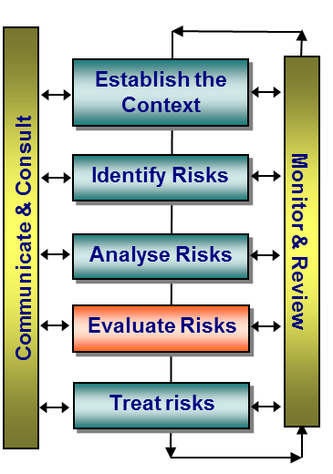
ISO 31000 ERM Framework (Evaluate Risk)
Mitigating practices and controls include all the policies, procedures, practices and processes in place to provide reasonable assurance of the management of Company’s risks
Where mitigating practices / controls exist but are not being followed and monitored, then adequate controls does not exist, as in order for mitigating practices / controls to be effective they also must be communicated, actioned and monitored
contents
Notes:
4th step of ERM framework
Types of controls
It is important that controls are appropriately designed to mitigate the risk and are operating effectively through out the period

Slide 13
ISO 31000 ERM Framework (Evaluate Risk)
Controls Rating Scale
 |  | Rating | Description
ADEQUATE | Excellent | 1 or 2 | Systems and processes exist to manage the risk and management accountability is assigned. The systems are well documented and regular monitoring/management review indicates high compliance to the process and that the system is effective in mitigating the risk.
 | Good | 3 or 4 | Systems and processes exist which manage the risk. Minor improvement opportunities have been identified but not yet actioned.
INADEQUATE | Fair | 5 or 6 | Some systems and processes exist to manage the risk.
 | Poor | 7 or 8 | Systems and processes for managing the risk have been subject to major change or is in the process of being implemented and its effectiveness cannot be confirmed.
 | Unsatisfactory | 9 or 10 | No systems and processes exist to manage the risk.
contents
Notes:
Controls rating scale
Interpretation of each level for guidance purposes

Slide 14
ISO 31000 ERM Framework (Evaluate Risk)
Interpretation of residual risk levels
Inherent Risk | Mitigating Practices / Control | Residual Risk | Action – Details
Extreme / High | Inadequate | Class IV - Active Management | Requires Immediate treatment and response with monthly progressing reports to Executive Risk Oversight Committee (EROC), respective SBU’s Board of Managers, and Board of Directors.
Extreme / High | Adequate | Class III – Control Critical | Actively manage / monitor at the SBU / BU Level, and Executive Risk Oversight Committee
Moderate / Low | Inadequate | Class II – Periodic Monitoring | Requires an appropriate treatment and response with progress reporting to the Tactical Risk Management Committee and respective Board of Managers.
Moderate / Low | Adequate | Class I – No Major Concern | Monitor and manage as required at the SBU / BU Level.
contents
Notes:
Table to be used for determining ‘residual risk rating’ (using inherent risk rating and controls rating)

Slide 15
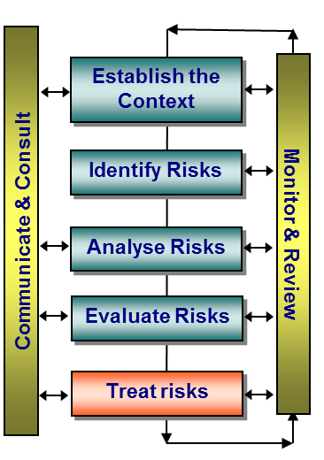
ISO 31000 ERM Framework (Treat Risk)
Risk treatment involves:
identifying the range of risk control or ‘treatment’ options;
evaluating those options;
selecting the preferred treatment;
preparing risk treatment plans; and
implementing them.
The risks owners develop risk treatment options based on one of the 4 options:
Avoid (Terminate), Accept (Tolerate), Mitigate (Treat), or Transfer
contents
Notes:
5th step of ERM framework
‘Risk Treatment’ process
Risk Treatment options

Slide 16
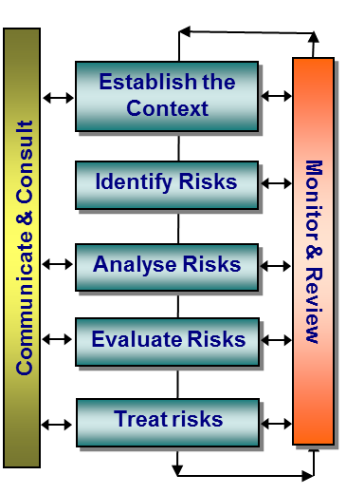
ISO 31000 ERM Framework (Monitor & Review)
The monitor and review process involves:
Preparation and issuance of a formal ‘Treatment Plans Ageing Report’. This report provides an insight to Risk Champions as to number of treatment plans which are ‘overdue’, due’ and ‘not yet due’
Follow-up with each Risk Champion on the implementation status of the treatment plans
Issuance of a formal consolidated ‘Treatment Plans Implementation Status Update Report’ to the TRMC and EROC
contents
Notes:
6th step of ERM framework
Key activities undertaken at Ma’aden to effectively implement the ‘Monitor and Review’ process

Slide 17
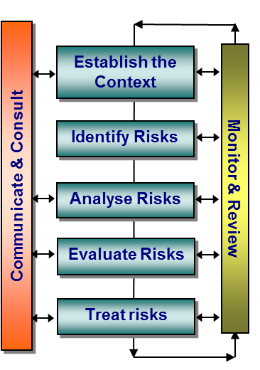
ISO 31000 ERM Framework (Communicate & Consult)
Why communicate & consult?
The process is an integral part of creating a positive risk management culture within the company. Taking a consultative approach to risk management, rather than a one way flow of information, stakeholders will understand the rationale behind decision making as well as their importance to managing Company’s risks
Furthermore, engaging in multilateral dialogue with stakeholders ensures the comprehensiveness and robustness of each step in the risk management process
Ways to communicate and consult include but are not limited to management and staff briefings, risk workshops, risk briefs and news letters, risk interviews, consultation with corporate ERM function etc.
contents
Notes:
7th step of ERM framework
Importance and ways to ‘communicate and consult’

Slide 18
ISO 31000 ERM Framework (ERM Governance Structure)
Board of Directors
Audit Committee
BoM of Affiliates
Executive Risk Oversight Committee (EROC)
CEO and President
Internal Audit
VP Finance
Class IV Risks escalated to Audit Committee
Head of ERM
Sharing of Risks and Controls Assessment
Review of ERM Function and Process
contents
Risk Filtering
Affiliate’s President
VPs of Businesses / Divisions
Tactical Risk Management Committee (TRMC)
Risk Filtering
Risk Champions assigned for each SBU / Department
Class III & IV Risks escalated to EROC
Risk Identification & Prioritization
Phosphate and IM SBU
Aluminium SBU
Precious Metals SBU
Waad’u Shammal & Project Mgt
Exploration
Finance & IT
Strategy Planning and Development
HR & Sustainability
MPC
MIMC
MA
MGBM
Notes:
1. FINAL version of the ERM governance structure
2. Approved by the EROC in its 2nd meeting held in August 2013

Slide 19
ISO 31000 ERM Framework (Risk Register Template)
Risk Reference
Number
Define Risk
Assign a Risk Category using ERM Quick Guide
Identify the root causes because of which this risk can materialize
Identify the possible consequences
should this
risk materialize
Assign Impact using Impact Scales in ERM Quick Guide
Add Likelihood and Impact to arrive at the inherent risk rating
Assign Likelihood using likelihood Scale in ERM Quick Guide
Identify and document the relevant controls in place to mitigate the risk
Identify the Control Owner
Document the control frequency
Arrive at the Residual Risk Rating (i.e. Net Risk)
using Interpretation Scale in the ERM Quick Guide
Assign Control Rating using Control Rating Scale in the ERM Quick Guide
Document the treatment plans that would best mitigate the risk
For every treatment plan documented, identify the Risk and Action owners
For every treatment plan documented, provide an implementation due date
Notes:
Step-by-step guidance for filling a risk sheet (risk register)

